Slide 1



Slide 2

Harmony
Hackathon
3 June 2024
Held at University College London
harmonydata.ac.uk/hackathon
github.com/harmonydata/

Slide 3
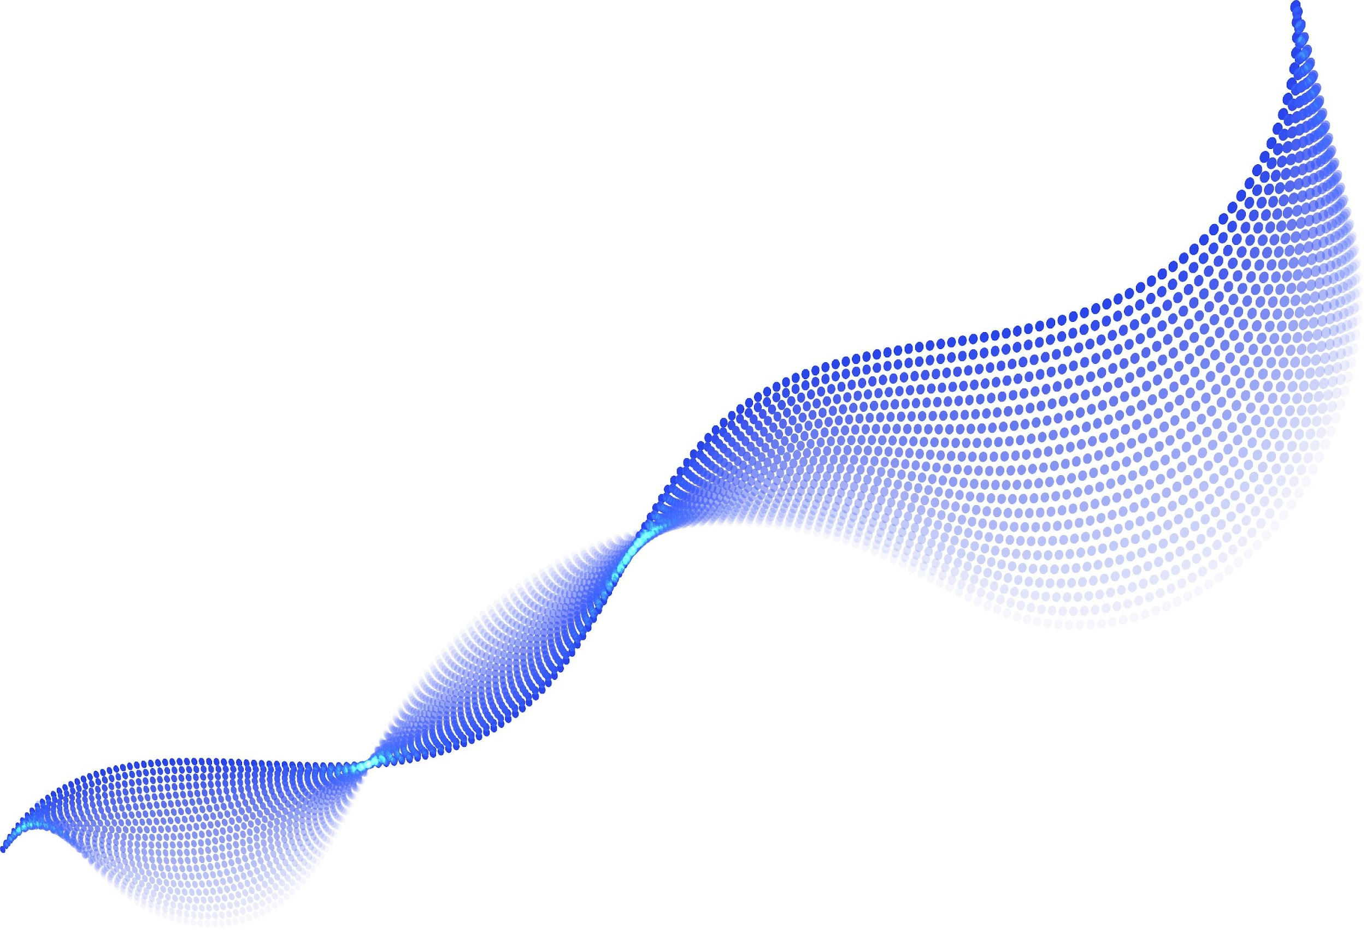

Harmony
Harmony is an open source project for psychologists to use for free around the world
MIT License
(any contributions to the main repo today are also MIT License)
It’s not a monetised product
SECTION
00

Slide 4


Partners

Slide 5

https://harmonydata.ac.uk/app

Slide 6






MEET THE TEAM
Eoin
McElroy
Bettina
Moltrecht
Mauricio
Hoffmann
George
Ploubidis
Thomas
Wood
Psychologist
Ulster
University
Psychologist
University College London
Psychologist
Universidade Federal de Santa Maria
Psychologist
University College London
Data science/software
Fast Data
Science
SECTION
00

Slide 7
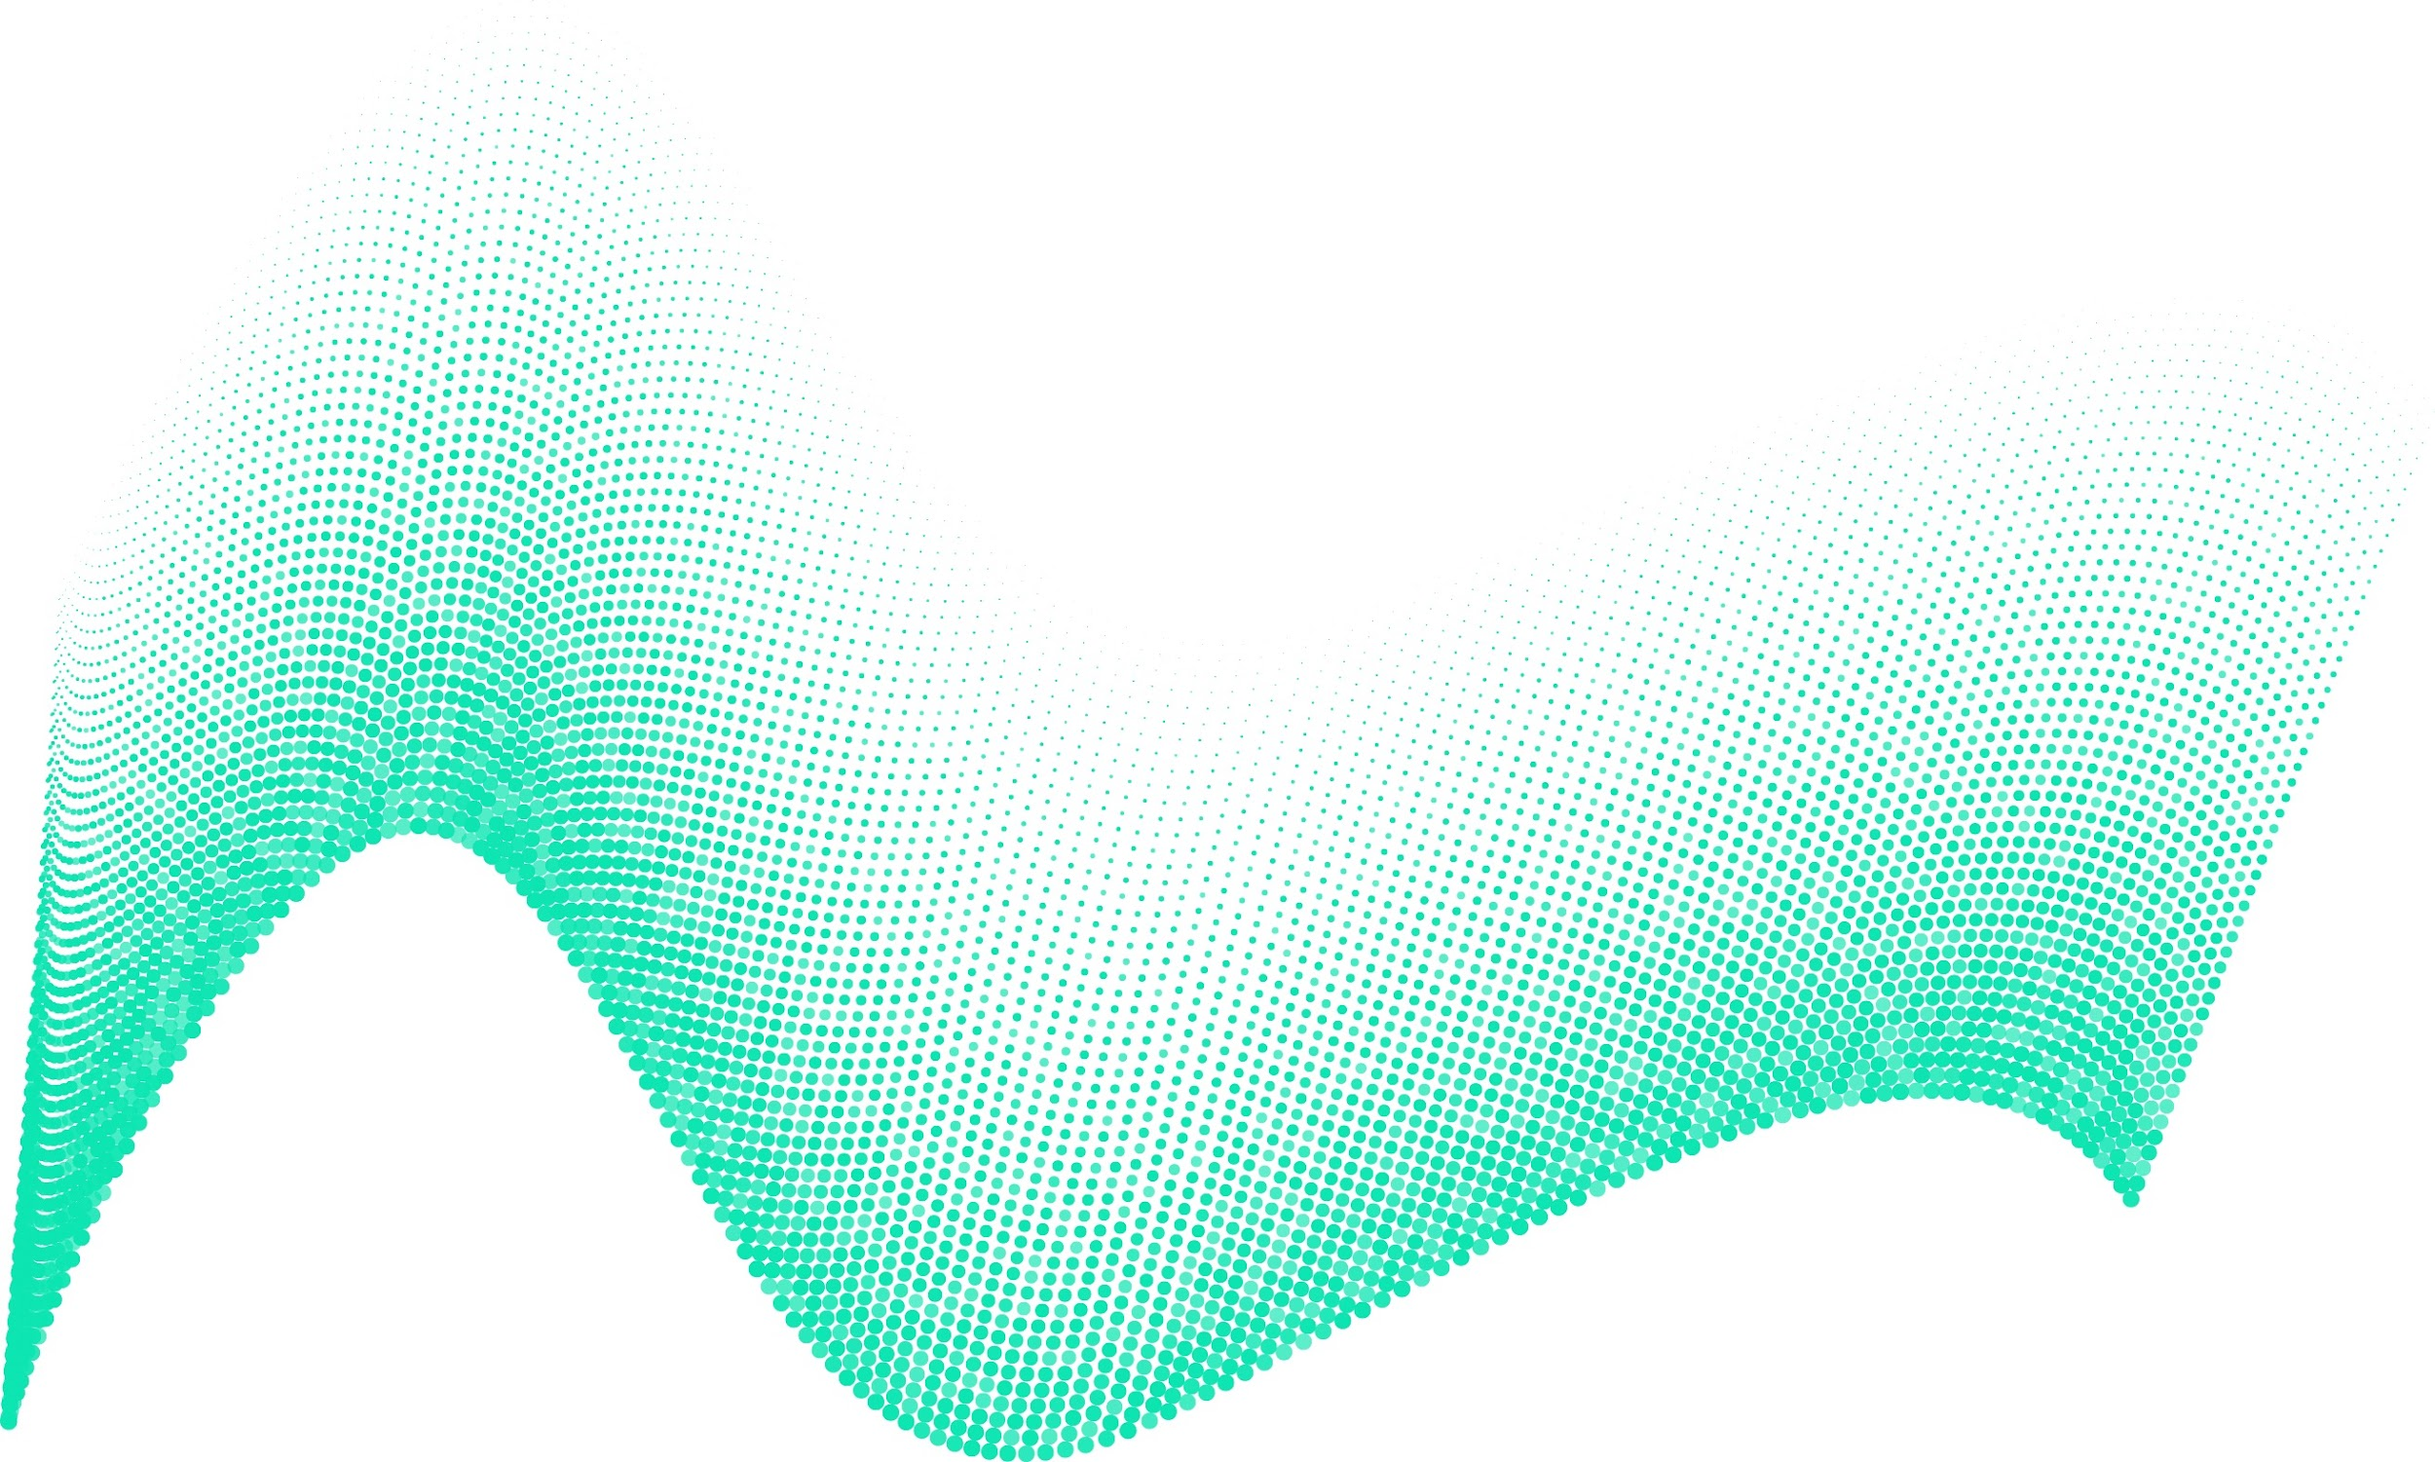
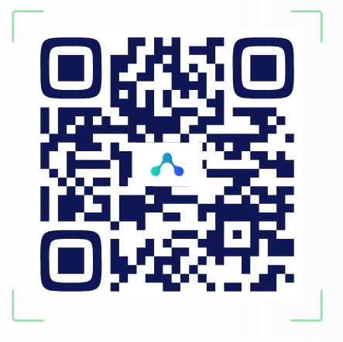
Discord
We can communicate today on Discord, “hackathon” room
discord.gg/harmonydata
SECTION
00

Slide 8
Harmony hackathon
We value input from all our participants and want everyone to enjoy our hackathon – behave professionally and show each other respect and courtesy
You can use Discord discord.gg/harmonydata to communicate with other participants!
Introduce yourself to your project team on Discord if you haven't already!
SECTION
00

Slide 9
Time | Activity
09:30 - 10:00 | Welcome talk Thomas Wood (Fast Data Science) Bettina Moltrecht (UCL) TBD (hackathon org)
10:00 – 12:15 | Breakout groups Recap and continue working on projects
12:30 - 13:30 | Lunch break
13:30-15:15 | Breakout groups Continue working on projects
15:15-15:30 | End of day tidy-up Write up; push to GitHub
15:30-16:30 | Group presentations 3 minutes per group; show us your notebooks! 😊 What you have achieved; key outputs; next steps
16:30-17:00 | Close of the Hackathon, feedback & next steps
SECTION
00

Slide 10
Hackathon ideas
https://harmonydata.ac.uk/ideas/
Project | Description
Project 1 | Improve the PDF parsing See https://github.com/harmonydata/pdf-questionnaire-extraction and Kaggle https://harmonydata.ac.uk/kaggle
Project 2 | Improve the matching algorithm: https://github.com/harmonydata/matching
Project 3 | Add different LLMs such as OpenAI, Google
Project 4 | Can you extend Harmony to work on Medical History Forms or Informed Consent Forms (ICFs)? Or market research documents! Other suggestions welcome!
Project 5 | Can you make Harmony’s negation work in multiple languages?
Project 6 | Response options (Likert) - extract them from PDF
Project 7 | Similarity function between questionnaires (H-score) - Word Movers Distance?
Anything else? | Open to ideas!!!
SECTION
00

Slide 11
PDF parsing
Address and fix issues related to processing PDFs within Harmony, as identified in the Kaggle competition.
Improve PDF handling for more seamless integration.
Handle Excels and Word docs.
https://github.com/harmonydata/harmony/issues/11
SECTION
00

Slide 12
2. Improve matching
Harmony often matches items that should not be matched, or vice versa, e.g.
Feeling tired or having little energy?
was incorrectly matched to
Having upsetting dreams that replay part of the experience or are clearly related to the experience?
https://github.com/harmonydata/matching
SECTION
00

Slide 13
3. Add LLMs
Can we integrate Harmony with OpenAI, Google, etc?
Open question: how to manage API keys, etc.
SECTION
00

Slide 14
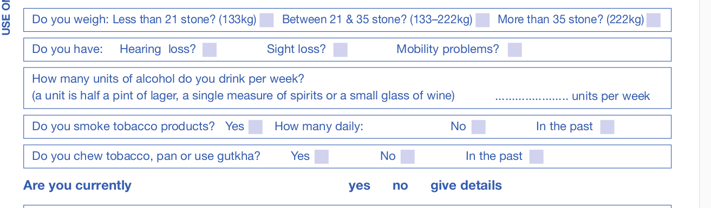
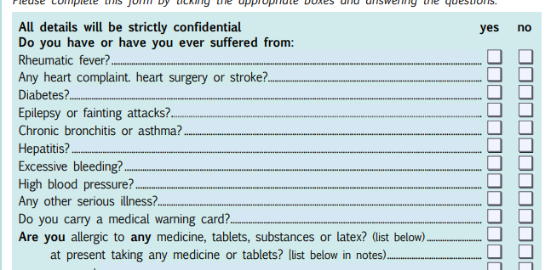
4. Medical history forms
Can we get Harmony to work on medical history forms?
Examples:
https://drive.google.com/drive/folders/1G8VAWEGasDwm30_sIxCs9uotB0sSV0IC?usp=drive_link
SECTION
00

Slide 15
5. Negation
Harmony currently identifies antonyms via a set of handwritten rules - inserting “not” (English) or “não” (Portuguese), etc. Can we improve this? Add more languages?
https://github.com/harmonydata/harmony/blob/main/src/harmony/matching/negator.py
SECTION
00

Slide 16
6. Handle response options (Likert)
We aren’t doing anything with the options like “very much so”, “somewhat frequently”, etc.
Can we start to get them from the PDF, or handle them in the matching?
SECTION
00

Slide 17
7. Give a similarity function between questionnaires (the H-score!)
Eve Cheng has done some experiments with the Word Movers Distance algorithm which gives the distance between two sequences of sentence embeddings.
Can Harmony use this to say that the GAD-7 is e.g. 60% similar to the PHQ-9?
See Colab notebook:
https://github.com/harmonydata/experiments/blob/main/harmony_wmd_experiment.ipynb
SECTION
00

Slide 18
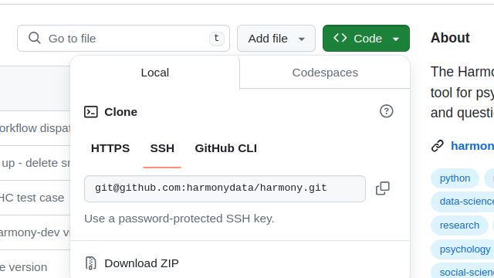
Getting started
You can use Windows, Linux or Mac
Clone the repository
Install Python 3.11
Install Pycharm
Install Jupyter Notebooks
Run the example Colab notebook (linked from homepage)
https://colab.research.google.com/github/harmonydata/harmony/blob/main/Harmony_example_walkthrough.ipynb
SECTION
00

Slide 19
Criteria for judgment
Innovative
Practical - can it be implemented in real Harmony?
Style and presentation
SECTION
00

Slide 20

How to get involved
Clone/Fork the Github
Use Harmony in research
Promote Harmony on social media
Make your changes in your fork
Please run all the unit tests
Check that the API and front end all run
Make a pull request
We merge your changes into main!
We’d love to see how Harmony can be used across social sciences, e.g. political sciences, law, market research, etc
Share on Instagram, LinkedIn, Twitter

Slide 21
Pushes and commits
Please use PEP-8 Linter
Please run unit tests before pushing
Check your PR hasn’t got any extra files made by your IDE that shouldn’t be committed, such as .vscode
SECTION
00

Slide 22
Please complete the feedback form
Please fill out our feedback form at the end of the session
https://forms.gle/WSXaoDiWu7XF8oKr5
We will post this on Discord channel under hackathon
SECTION
00

